Slide 1

STACK
Ankit Raya - 03
Ashmita Bhatta – 04
Atul Shrestha - 05

Slide 2
STACK
A linear type of data structure that follows the LIFO (Last-In-First-Out) principle.
Allows insertion and deletion operations from one end called the top of stack.
Inserting a new element in the stack is termed a push operation.
Removing or deleting elements from the stack is termed pop operation.
Real-life examples of a stack are a deck of cards, piles of books, piles of money, and many more.

Slide 3
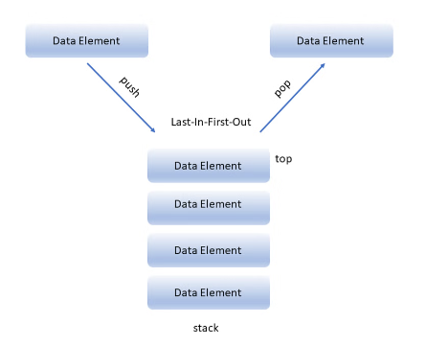
STACK REPRESENTAION

Slide 4
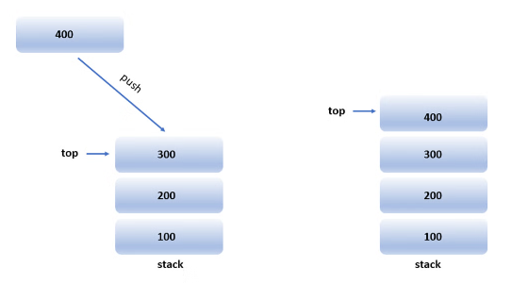
Basic Operations on Stack
Push Operation
Push operation involves inserting new elements at the top of the stack.

Slide 5
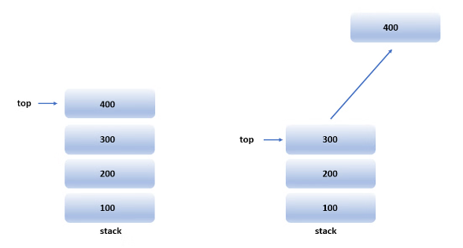
Basic Operations on Stack
Pop Operation
Pop operation refers to removing the element from the top of the stack.

Slide 6
Basic Operations on Stack
Peek Operation
Peek operation refers to retrieving the topmost element in the stack without removing it from the stack.
isFull()
isFull function is used to check whether or not a stack is full.
isEmpty()
isEmpty function is used to check whether or not a stack is empty.

Slide 7
APPLICATIONS OF STACK
Here are some applications of the stack:
Expression Evaluation and Conversion
Backtracking
Function Call
Parentheses Checking
String Reversal
Syntax Parsing
Memory Management

Slide 8
IMPLEMENTATION USING ARRAYS
import tkinter as tk
from tkinter import messagebox
class Stack:
def __init__(self, max_size = 5):
self.stack = []
self.max_size = max_size
def push(self, item):
if len(self.stack) >= self.max_size:
return "Stack is full"
self.stack.append(item)
def pop(self):
if len(self.stack) < 1:
return None
return self.stack.pop()
def peek(self):
if not self.stack:
return None
return self.stack[-1]
def is_empty(self):
return len(self.stack) == 0
def is_full(self):
return len(self.stack) == self.max_size

Slide 9
IMPLEMENTATION USING ARRAYS
class Application(tk.Frame):
def _init_(self, master=None):
super()._init_(master)
self.master = master
self.pack()
self.create_widgets()
def create_widgets(self):
self.stack = Stack(6)
self.label = tk.Label(self)
self.label["text"] = "Stack: " + str(self.stack.stack)
self.label.pack(side="top")
self.size_label = tk.Label(self, text="Size of Stack")
self.size_label.pack(side="top")
self.size_entry = tk.Entry(self)
self.size_entry.pack(side="top")
self.size_button = tk.Button(self)
self.size_button["text"] = "Declare size"
self.size_button["command"] = self.declare_stack
self.size_button.pack(side="top")
self.item_label = tk.Label(self, text="Item to add")
self.item_label.pack(side="top")
self.item_entry = tk.Entry(self)
self.item_entry.pack(side="top")
self.push_button = tk.Button(self)
self.push_button["text"] = "Push"
self.push_button["command"] = self.push_item
self.push_button.pack(side="left")
self.pop_button = tk.Button(self)
self.pop_button["text"] = "Pop"
self.pop_button["command"] = self.pop_item
self.pop_button.pack(side="right")

Slide 10
IMPLEMENTATION USING ARRAYS
self.peek_button = tk.Button(self)
self.peek_button["text"] = "Peek"
self.peek_button["command"] = self.peek_item
self.peek_button.pack(side= "left")
self.peek_label = tk.Label(self)
def declare_stack(self):
size_of_stack = int(self.size_entry.get())
print(size_of_stack)
self.stack = Stack(size_of_stack)
def push_item(self):
item = self.item_entry.get()
if self.stack.is_full():
messagebox.showerror("Error", "Stack is full")
else:
self.stack.push(item)
self.label["text"] = "Stack: " + str(self.stack.stack)
def pop_item(self):
if self.stack.is_empty():
messagebox.showerror("Error", "Stack is empty")
else:
self.stack.pop()
self.label["text"] = "Stack: " + str(self.stack.stack)
def peek_item(self):
if self.stack.is_empty():
messagebox.showerror("Error", "Stack is empty")
else:
self.stack.peek()
self.peek_label["text"] = "Peeked item: " + str(self.stack.stack[-1])
self.peek_label.pack(side="bottom")

Slide 11
DEMO

Slide 12
INFIX, POSTFIX AND PREFIX
Infix, Postfix and Prefix notations are three different but equivalent ways of writing expressions.
Infix notation: X + Y
Operators are written in-between their operands. This is the usual way we write expressions.
Operator precedence and associativity, and brackets ( )
E.g: A * ( B + C ) / D
Prefix notation (also known as "Polish notation"): + X Y
Operators are written before their operands. The expressions given above are equivalent to
/ * A + B C D
Postfix notation (also known as "Reverse Polish notation"): X Y +
Operators are written after their operands. The infix expression given above is equivalent to
A B C + * D /

Slide 13
INFIX TO POSTFIX CONVERSION
Step 1: Repeat until each character in the infix notation is scanned
1.1: IF a "(" is encountered, push it on the stack
1.2: IF an operand ( whether a digit or a character) is encountered, add it postfix expression.
1.3: IF a ")" is encountered, then a. Repeatedly pop from stack and add it to the postfix expression until a "(" is encountered. b. Discard the "(". That is, remove the “(“ from stack and do not add it to the postfix expression
1.4: IF an operator O is encountered, then a. Repeatedly pop from stack and add each operator (popped from the stack) to the postfix expression which has equal or higher precedence than O b. Push the operator O to the stack.
Step 2: Repeatedly pop from the stack and add it to the postfix expression until the stack is empty

Slide 14
EVALUATING A POSTFIX EXPRESSION
Step 1: Make operand-stack empty.
Step 2: For each symbol symb in the postfix expression (scanning from left to right), repeat:
2.1. If symb is an operand:
2.1.1. Add symb to at the top of the operand-stack.
2.2. Otherwise (if symb is an operator):
2.2.1. Remove the topmost element from the operand-stack and place it in opnd2.
2.2.2. Remove the topmost element from the operand-stack and place it in opnd1.
2.2.3. Store the result of applying symb (operator) to opnd1 and opnd2 in value.
2.2.4. Insert value to the top of the operand-stack.
Step 3: Remove and return topmost element from the operand-stack

Slide 15
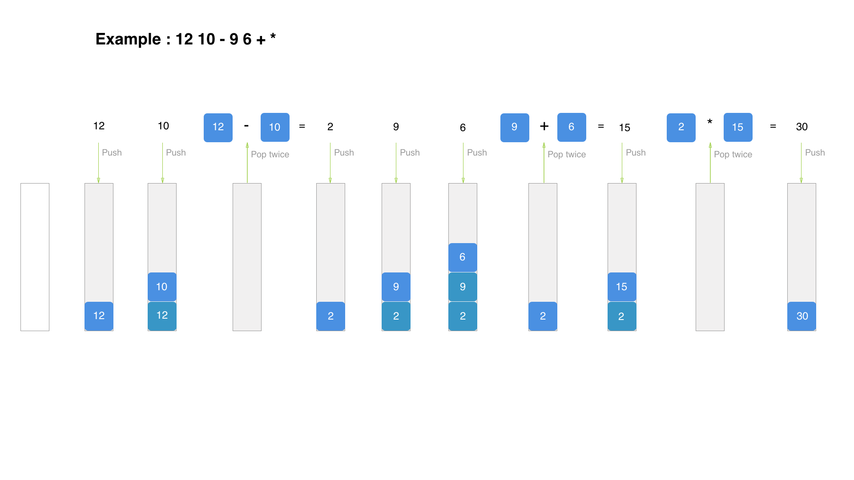
EVALUATING A POSTFIX EXPRESSION

Slide 16
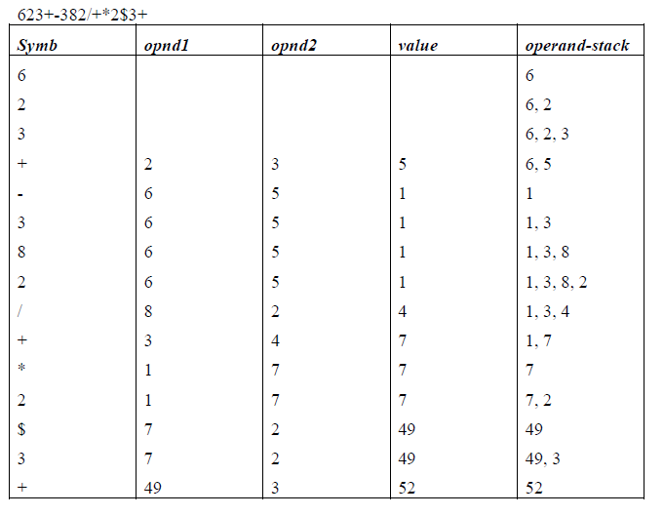
EVALUATING A POSTFIX EXPRESSION

Slide 17
THANK YOU

